Slide 1
YOU'RE IN CONTROL
Quimin manages our social media activity with KAWO, giving you complete oversight across all activity.
Read more.

Slide 2
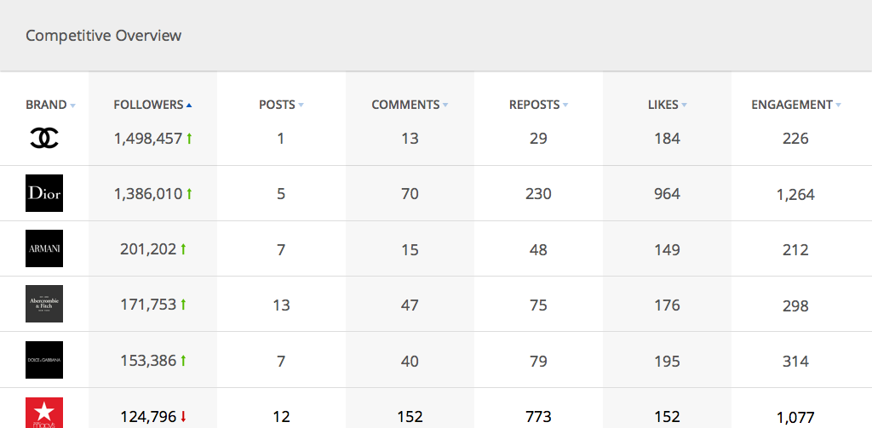
INTELLIGENCE
Get competitive intelligence, professional benchmarking and industry trending topics to always stay ahead of the pack.

Slide 3
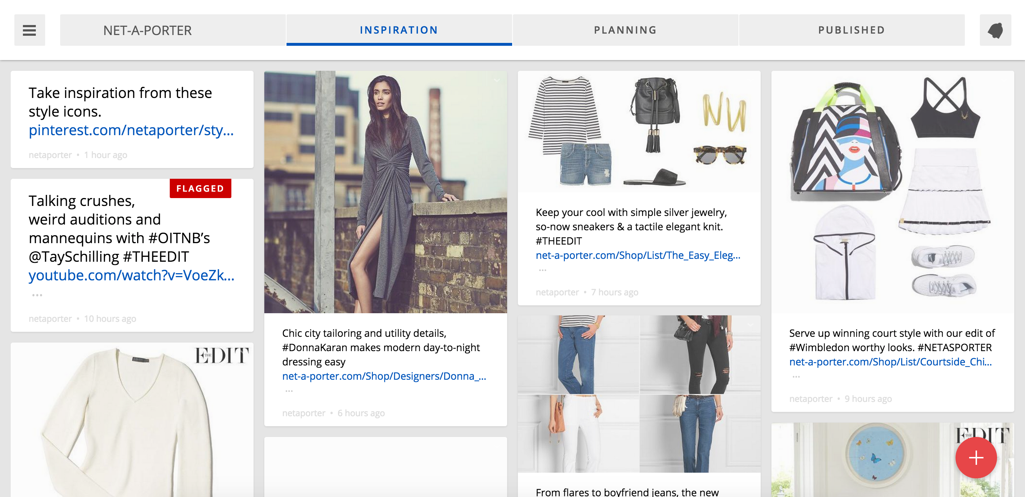
COLLABORATION
Our teams will collaborate across one platform, source inspiration from your branded facebook, twitter & Instagram, plan and publish to China's biggest social networks.

Slide 4
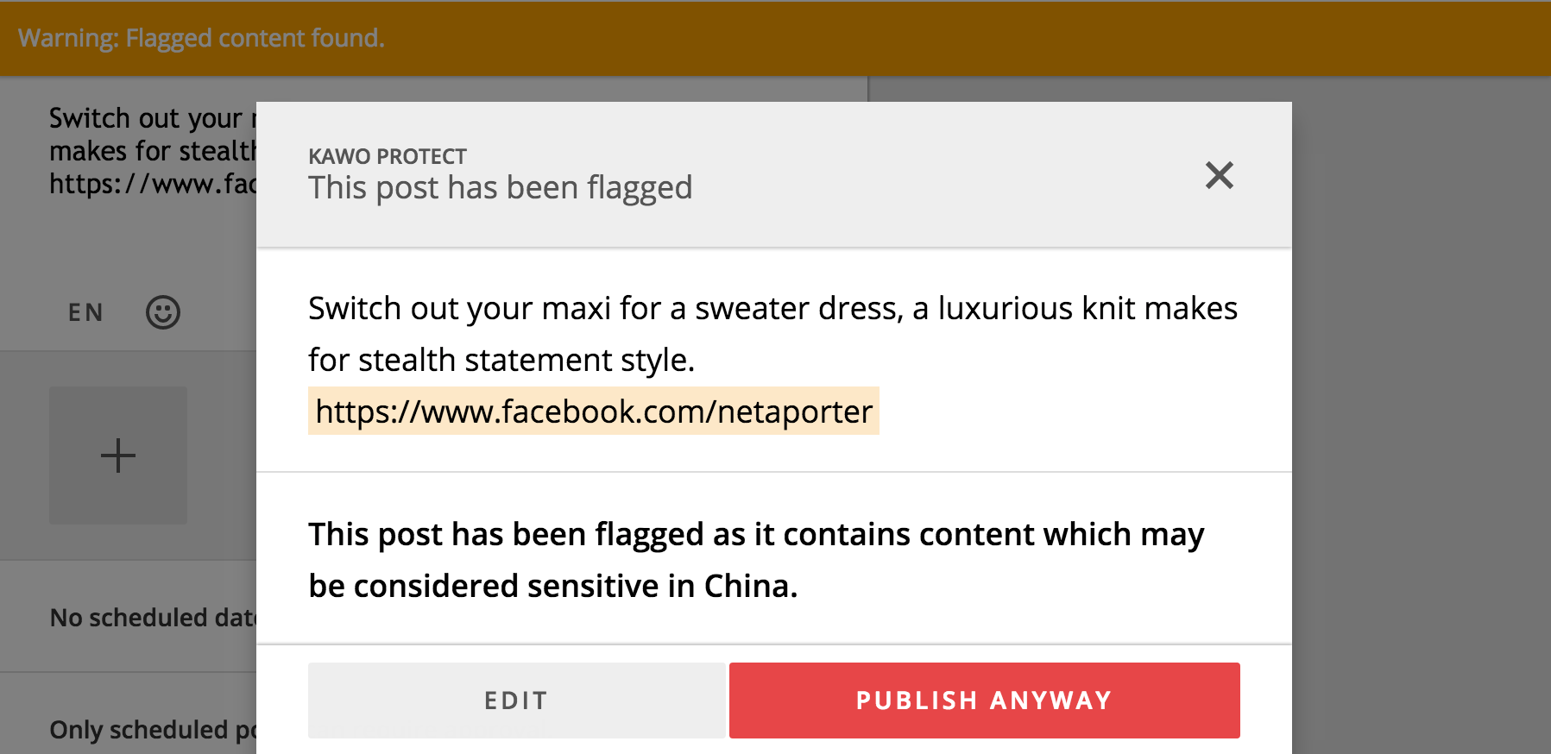
PROTECTION
Our team double check all posts, and KAWO's system will screen each post against China's sensitivities, ensuring you are always safe.

Slide 5
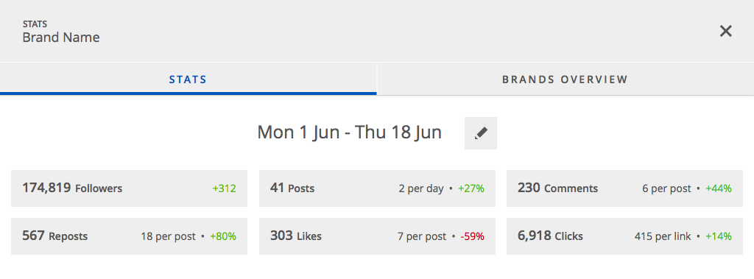
PERFORMANCE
Receive to the minute performance tracking on engagement, click throughs and ROI on social media activity.

Slide 6
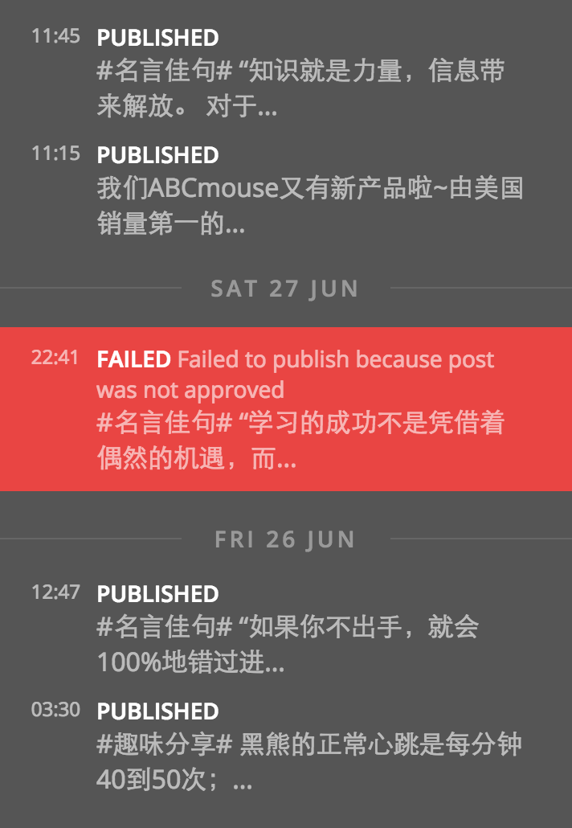
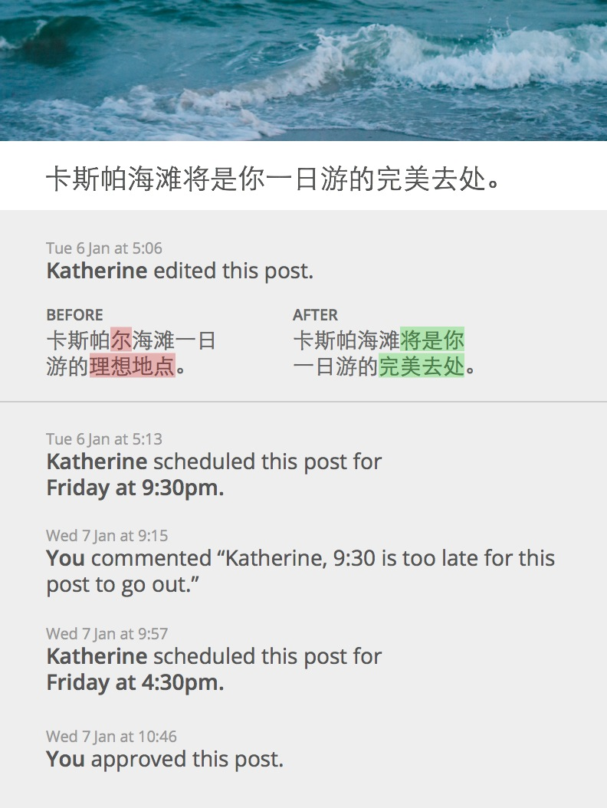
TRANSPARENCY
Every post, every action tracked all the time.

